Slide 1




Topic: Storm and Heavy Rainfall Prediction
College: Lokmanya Tilak College of Engineering
Students: Kushal Nishad
Saurav Patil
Ruturaj Desai

Slide 2

Learning Objectives
Understand the significance of weather prediction in disaster prevention
Learn how to preprocess and analyze weather datasets
Apply machine learning algorithms to forecast heavy rainfall and storms
Evaluate model performance using real-world metrics
Explore deployment of AI-based weather prediction systems
GOAL

Slide 3
Tools and Technology used
Languages: Python
Libraries: Pandas, NumPy, scikit-learn, XGBoost, Matplotlib, Seaborn
Tools: Google Colab
Datasets: IMD, NOAA, Kaggle
Icons/Graphics: www.freepik.com
Dataset Overview
Meteorological Data: Weather conditions (real-time or historical)
Storm Event Data: Official storm reports
Rainfall Measurements: Precipitation in mm or inches
Satellite Data (optional): For cloud coverage, wind patterns, etc.

Slide 4
Methodology
1. Data Collection (weather records from IMD/NOAA)
2. Data Cleaning & Preprocessing
3. Exploratory Data Analysis (EDA)
4. Feature Selection and Engineering
5. Model Training: Logistic Regression, Random Forest, XGBoost
6. Evaluation using accuracy, F1 score, confusion matrix
7. (Optional) Deployment using a web interface

Slide 5
Alogrithms used:
1. Logistic Regression
Baseline model for binary classification (rain/storm vs. no rain/storm)
Fast, interpretable, and good for linearly separable data
2.Decision Tree
Splits data based on feature thresholds
Easy to understand, but may overfit
3.Random Forest
Ensemble of decision trees
Reduces overfitting, works well with complex data
4.XGBoost
Boosting-based model
High accuracy, handles missing values, widely used in competitions
5. Support Vector Machine (SVM)
Finds the optimal hyperplane for class separation
Effective in high-dimensional space
6. K-Nearest Neighbors (KNN)
Classifies based on closest data points
Simple, but slower with large datasets

Slide 6
Problem Statement:
Unpredictable rainfall and storms cause massive damage to life, agriculture, and infrastructure. Traditional systems often lack real-time accuracy. The challenge is to build an AI model that can forecast these events early and reliably.
Solution:
A machine learning-based solution that:
Predicts storm or heavy rain likelihood from historical weather inputs
Uses classification (e.g., logistic regression, random forest)
Generates alerts for potential disasters with minimal false positives

Slide 7
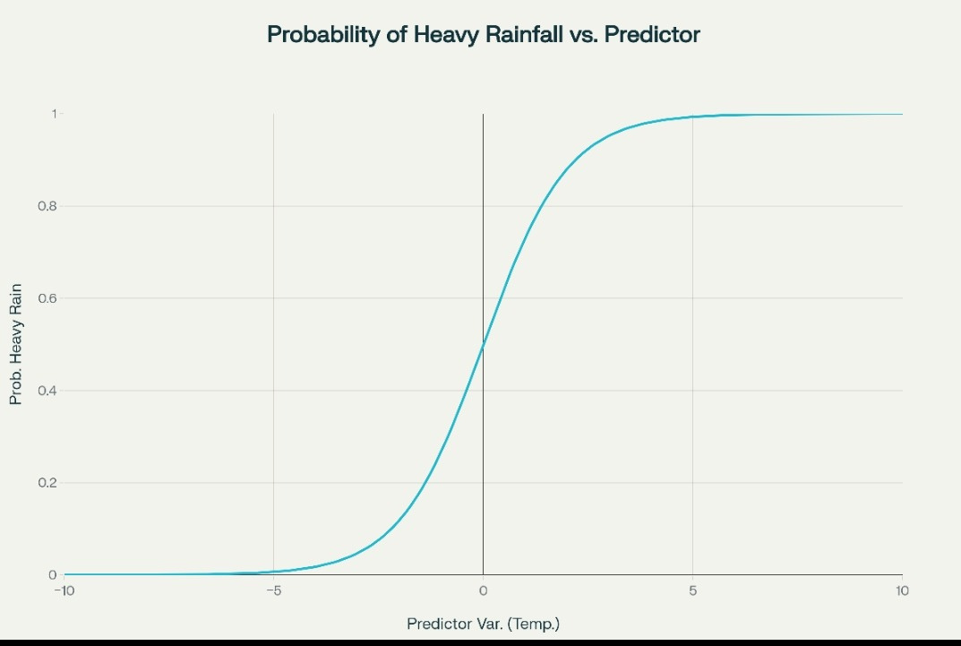
Screenshot:

Slide 8
Conclusion:
The AI/ML model provides a data-driven approach to predicting heavy rainfall and storms. It supports early warning systems, urban planning, and agricultural decision-making. With further training and integration into live weather systems, it can significantly reduce risk and improve preparedness.
GitHub repository link of the project
git@github.com:Soro2006/edunet.git

